Slide 1
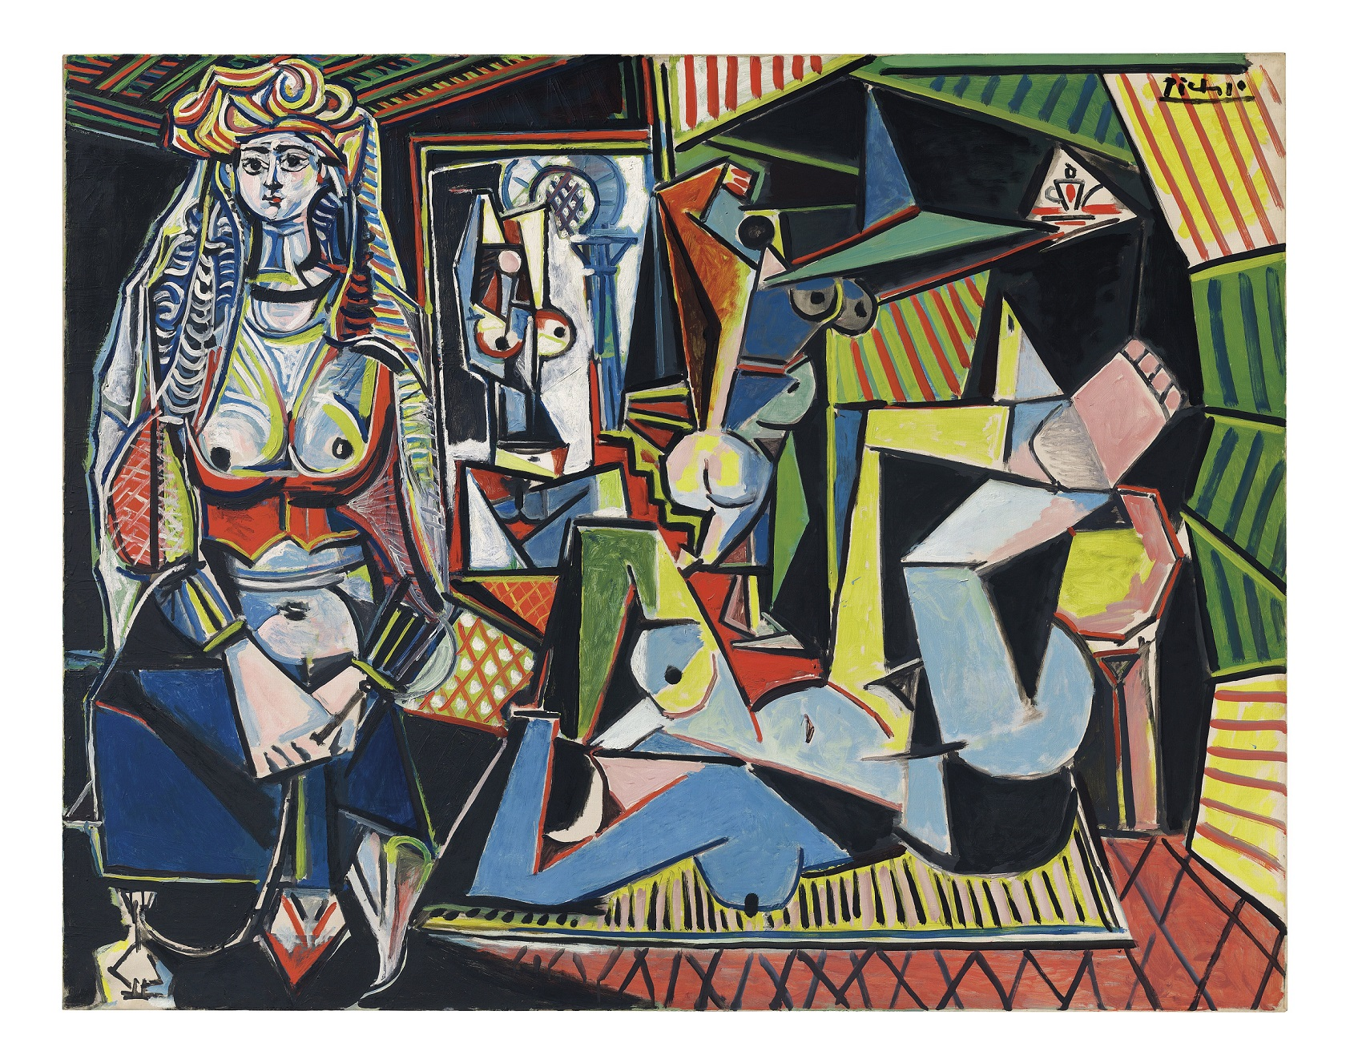
Style Transfer Using Deep Learning

Slide 2
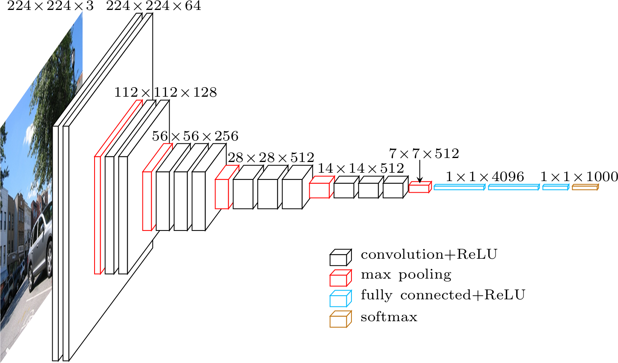
Overview
Use deep neural networks to transform an image into the style of another image using the higher level features provided by deep nets.

Slide 3

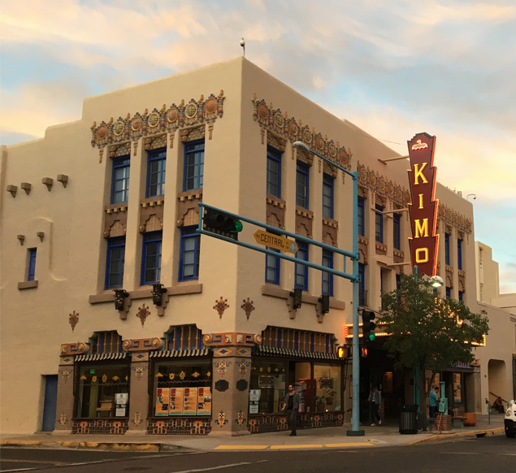
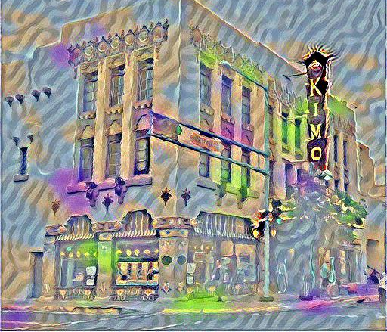
Preparation
Find two images
An image that will be changed
An image with an interesting style

Slide 4
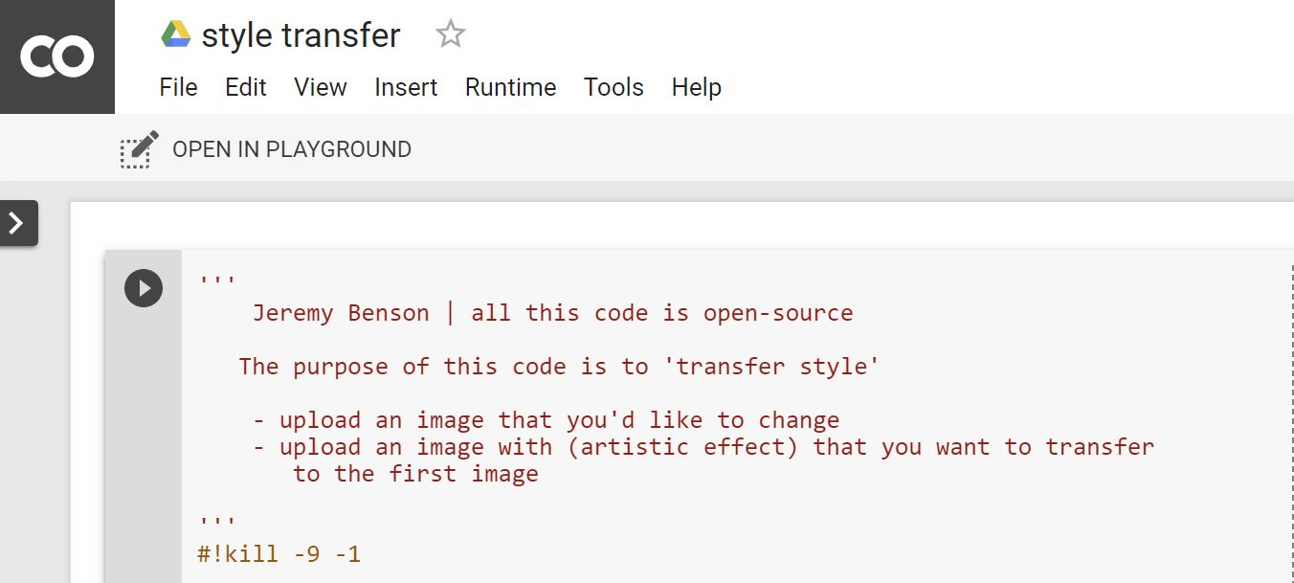
Code
Open the code on Google Colaboratory using the following link
https://colab.research.google.com/drive/1aXTf_KSN6uQAgIS7VXkB3bVdzgIj69mj

Slide 5
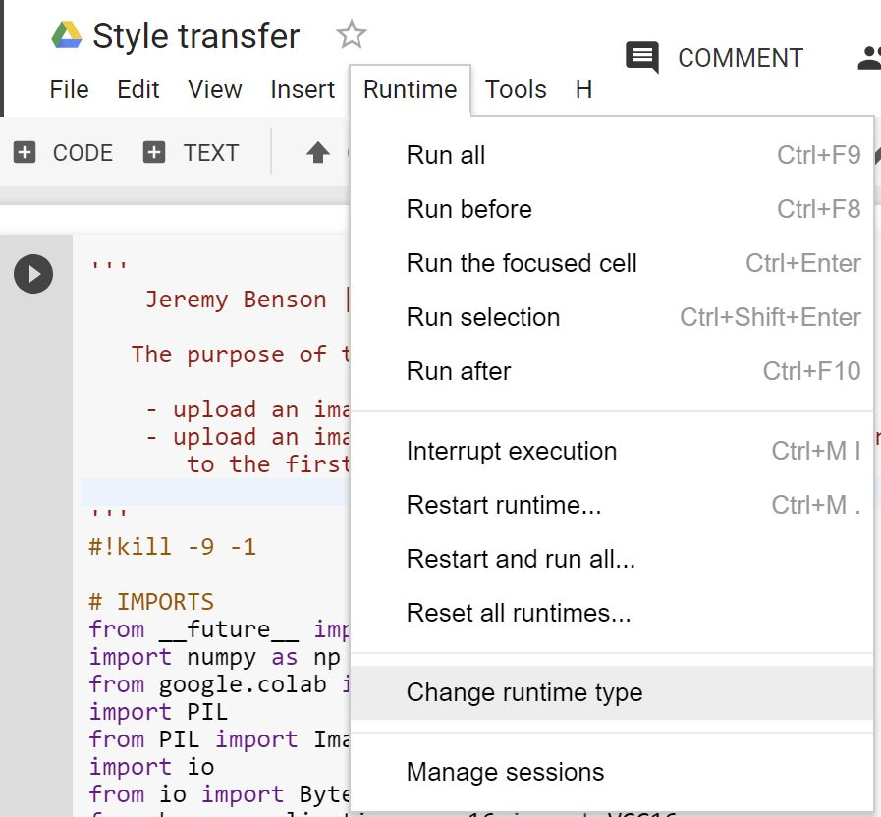
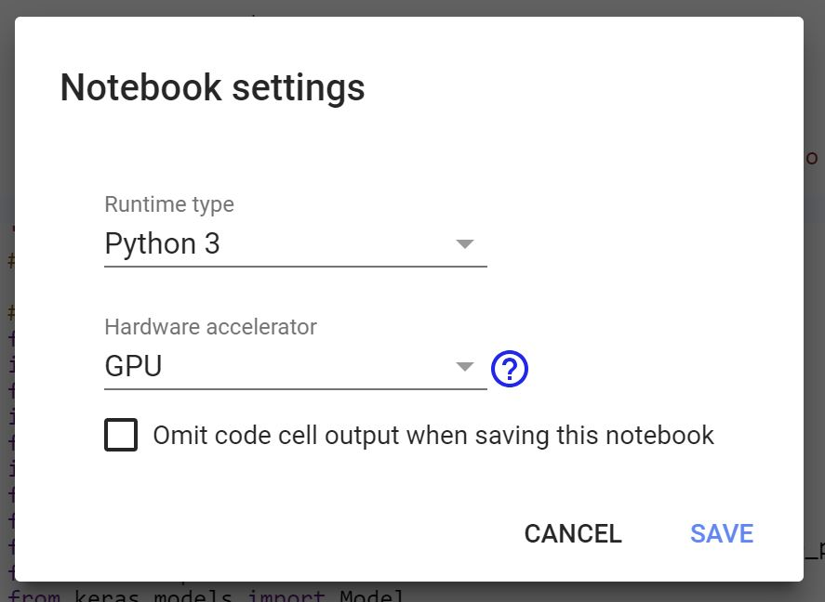
Change the hardware accelerator to GPU

Slide 6
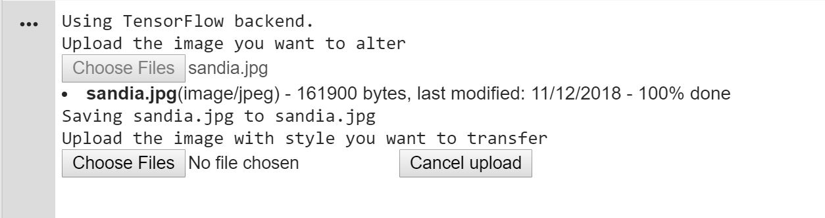
Press the play button to run the code.
Scroll to the bottom of the code. Here you will have a chance to upload your images.

Slide 7
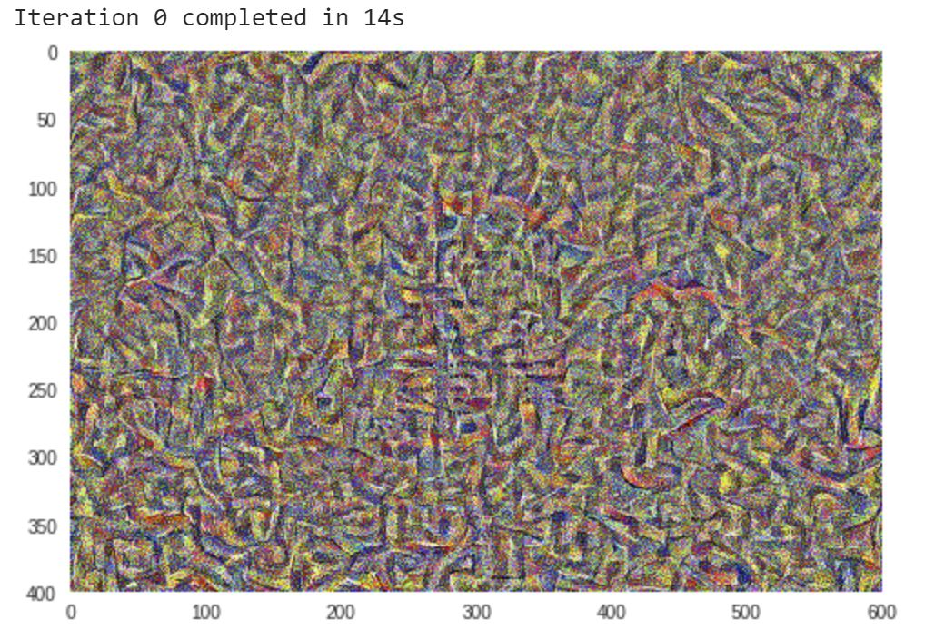
After each iteration, the current result will be displayed
The program will run for 20 iterations for about 4 minutes
How are the results?

Slide 8
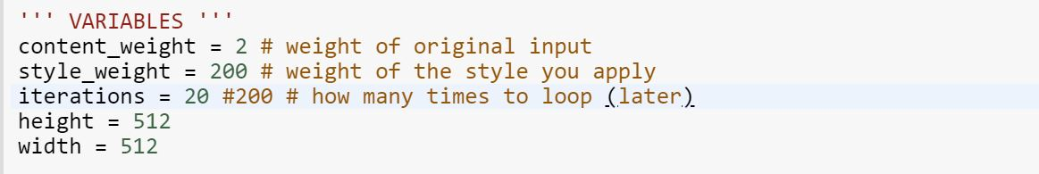
High-level Settings
Different settings work better for different images and we can also get different results. Try changing some of these.
Content weight : how much do we weigh the error of the result in retaining the information of the content image
Style weight : how much do we weight the error of the result in retaining the information of the style image
Iterations : for how many steps do we optimize the results. More is better
Height and Width : larger images take longer to run but look better

Slide 9
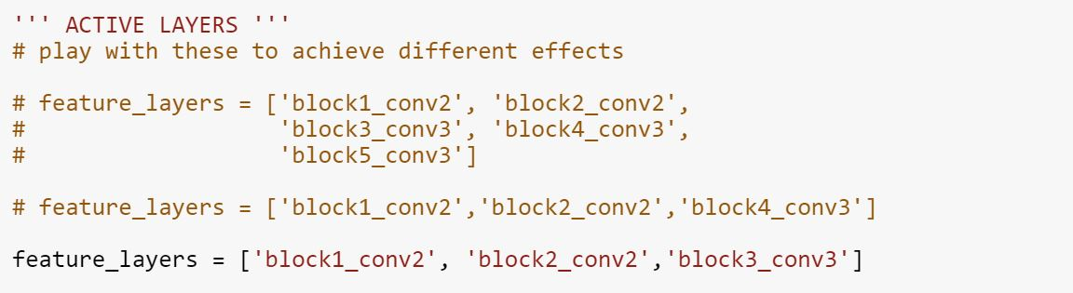
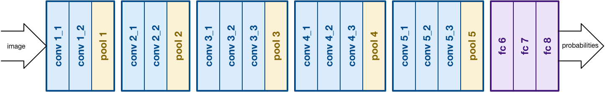
Low-level Settings
Which layers do we use to compute the style?
Names based on the names for each layer of VGGNet

Slide 10
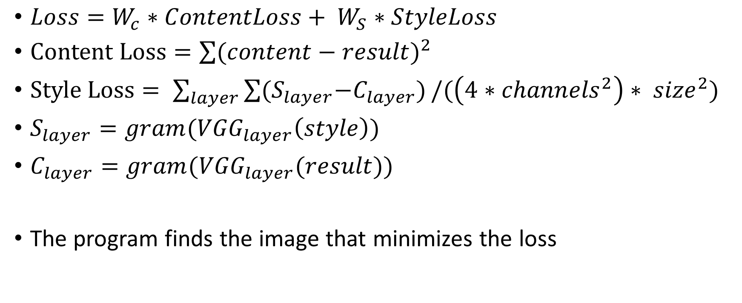
Appendix
$Loss=W_{c}∗ContentLoss+ W_{S}∗StyleLoss$
$Content Loss=\sum{{(content−result)}^{2}}$
$Style Loss= \sum_{layer}{\sum{{(S}_{layer}−C_{layer})}}/(\left(4∗{channels}^{2}\right)∗ {size}^{2})$
$S_{layer}=gram({VGG}_{layer}\left(style\right))$
$C_{layer}=gram({VGG}_{layer}(result))$
The program finds the image that minimizes the loss

